Slide 1




Smart Parking System
Team: Fo lo ren ti no

Slide 2
Members: | Mentor:
Le Duc Nguyen Huy Tu Ngo Le Xuan Phuc Le Phan Nam Hoang Van Kien | Nguyen Tuan Anh

Slide 3



1
Introduction
2
Ideas
3
System building
4
Summary
5
Development ideas

Slide 4
1. Introduction

Slide 5
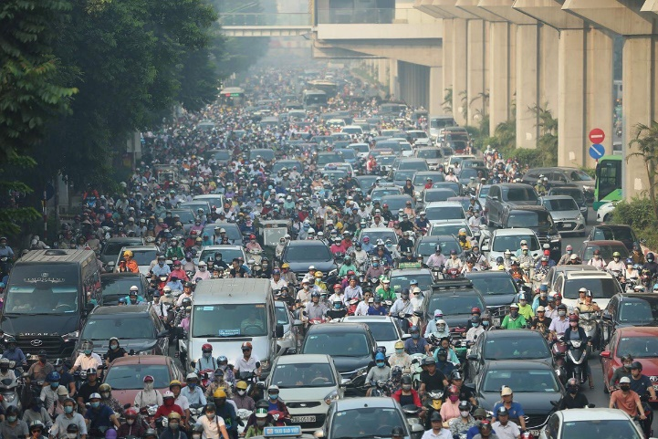
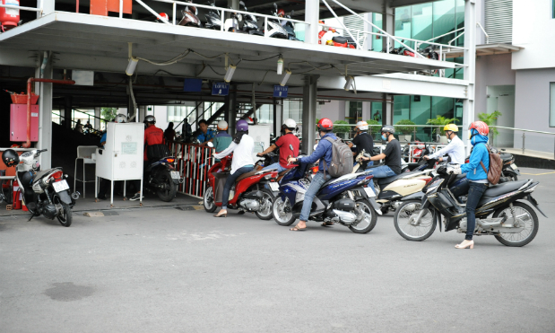
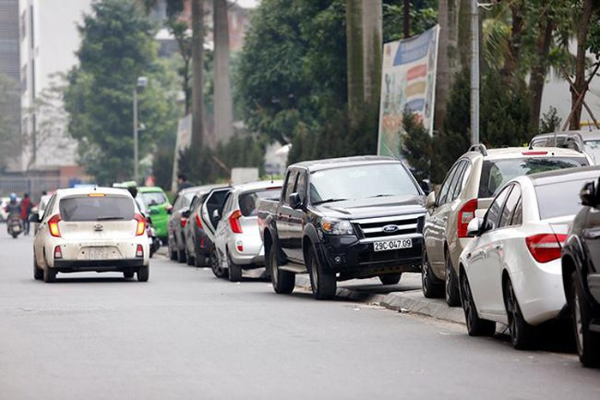
1.1 Issues
…
Increasing Number Of Vehicles
Time - consuming
Pavement Parking
Nowadays, traditional parking garages are gradually unable to meet the needs of the people

Slide 6
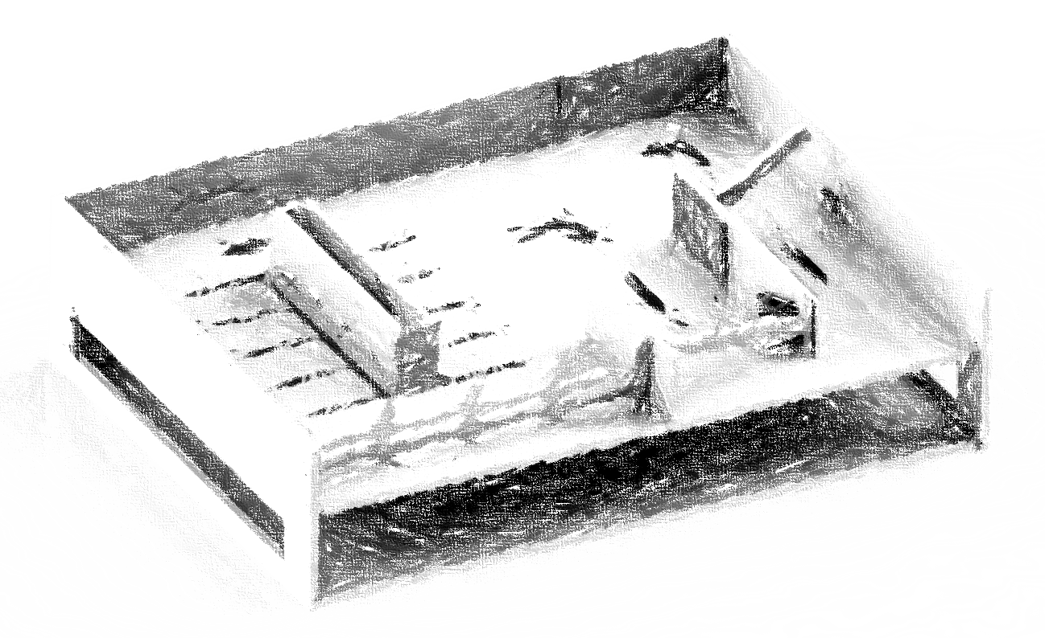
1.2 Solutions
Building an IoT System which helps users to find parking lots and parking zones
Using mobile apps to help users update garage information remotely
Applying image processing, RFID and warnings to increase safety for garages

Slide 7
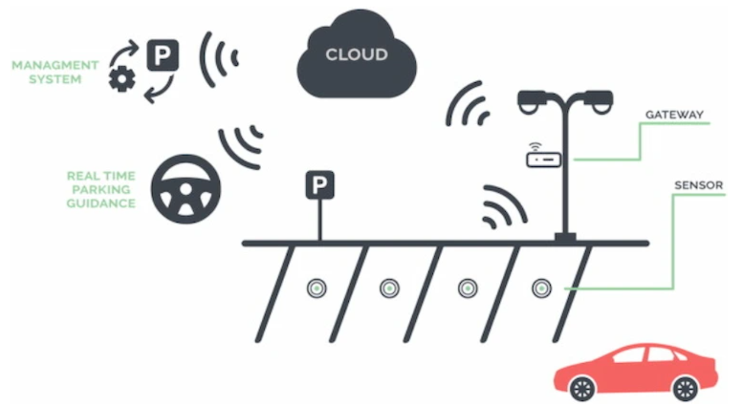
1.3 Target
Safety
Security - customer property
Convenient
Users can easily use the service
Savings
Saving cost
Save time

Slide 8
2. Ideas

Slide 9
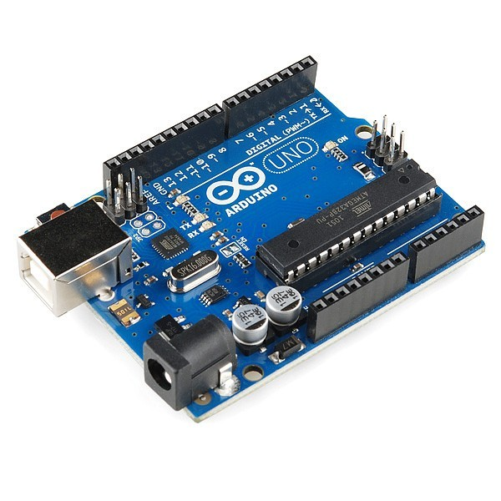
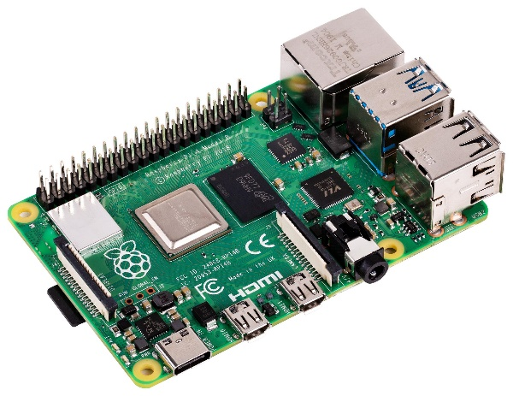
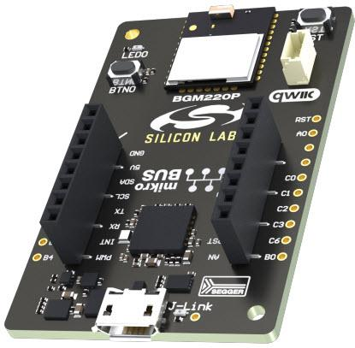
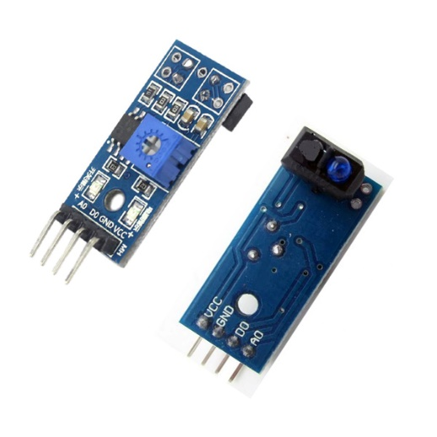
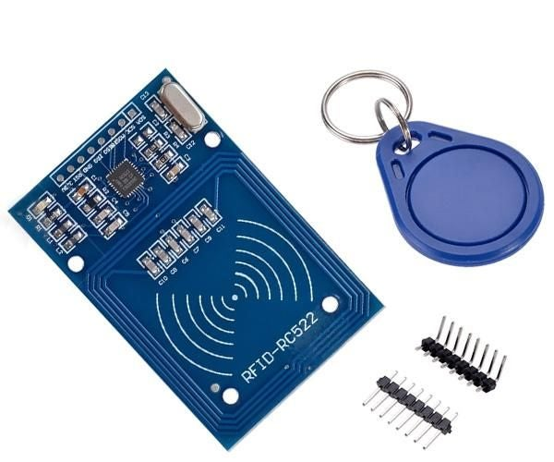
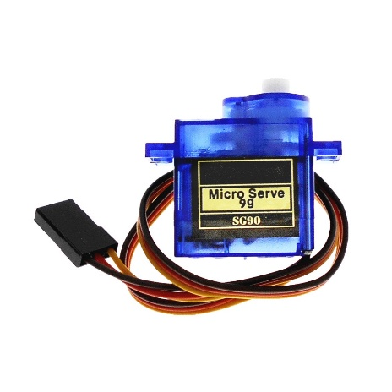
2.1 Hardware
Arduino UNO
Raspberry Pi 4 Model B
BGM220 Bluetooth Module Explorer Kit
IR Sensor
RFID
Servo Motor SG90

Slide 10







2.2 Software

Slide 11
3. System building

Slide 12

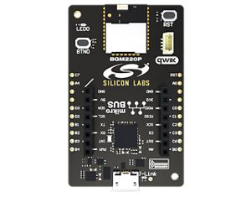

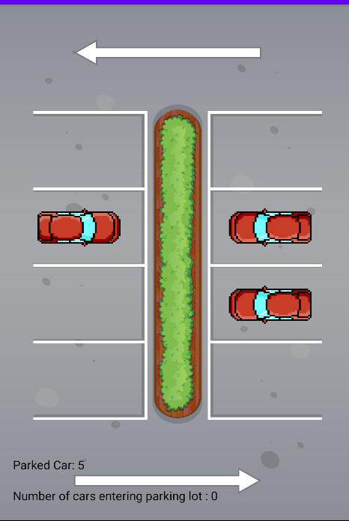
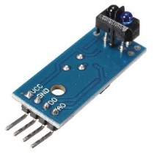

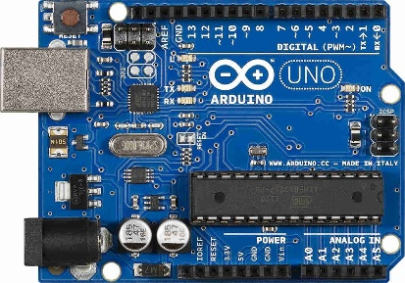

3.1 System diagram
Http
Http
Mesh Bluetooth
UART
Gateway
I2C
Sensor
SPI
User Interface
RFID

Slide 13
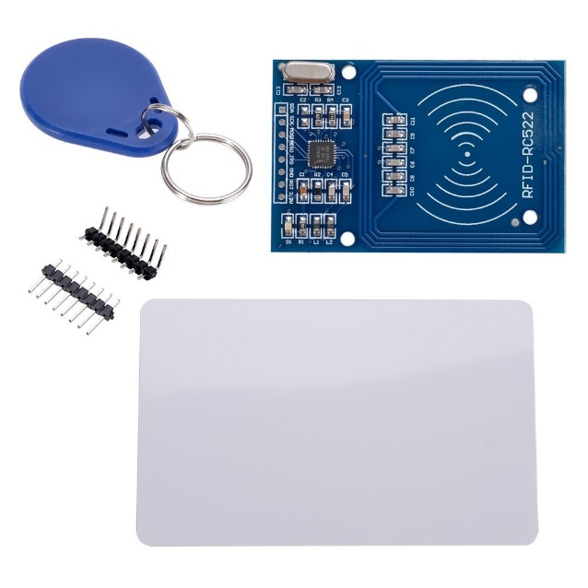
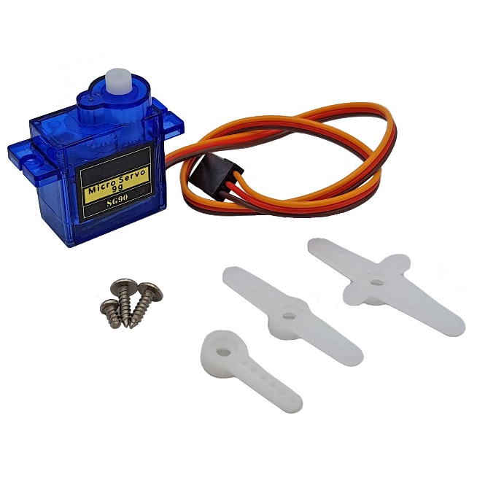
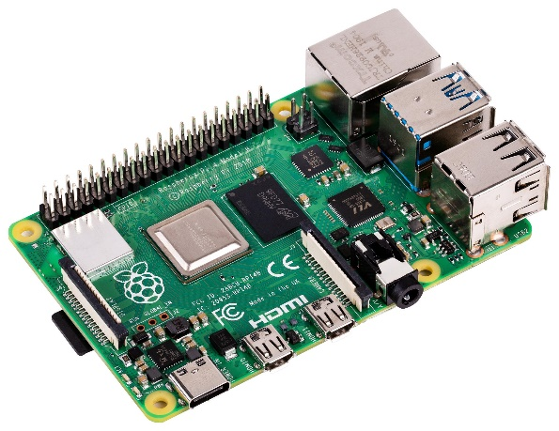
3.2 Vehicle access management system
RFID
Entry / Exit Parking Management
Increase security
Servo
Automatic Open Close barrier arm gate
Raspberry Pi
Receive data from vehicle

Slide 14
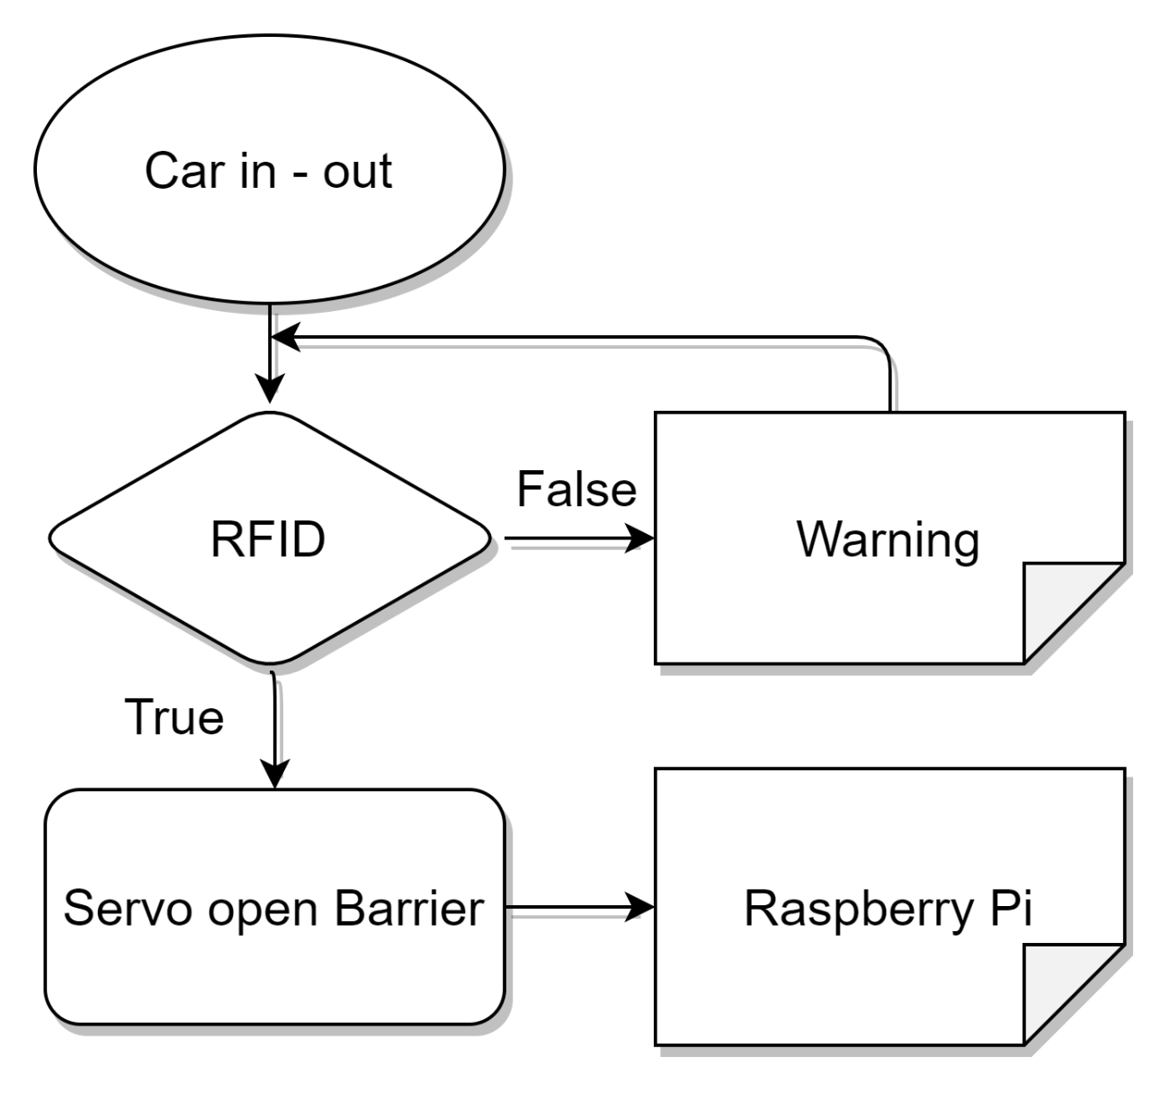
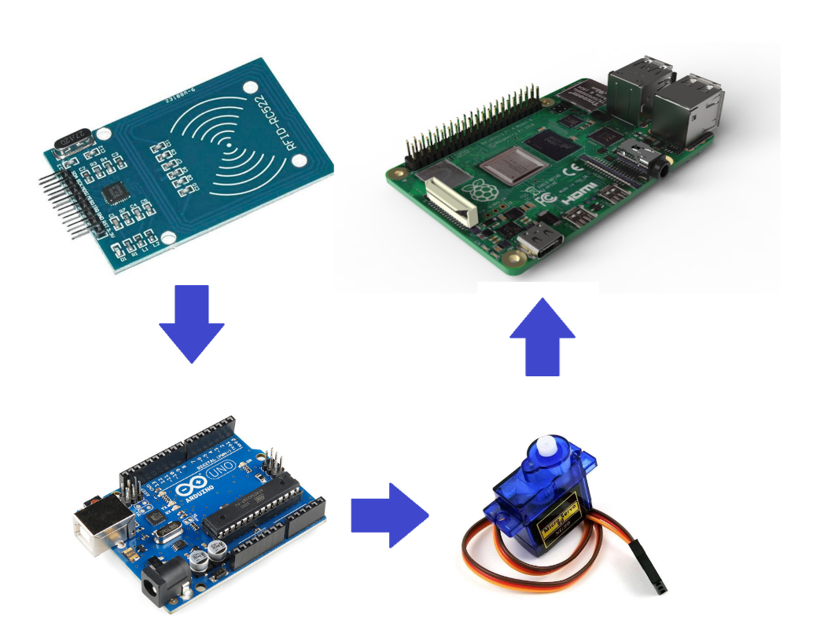

3.2 Vehicle access management system

Slide 15
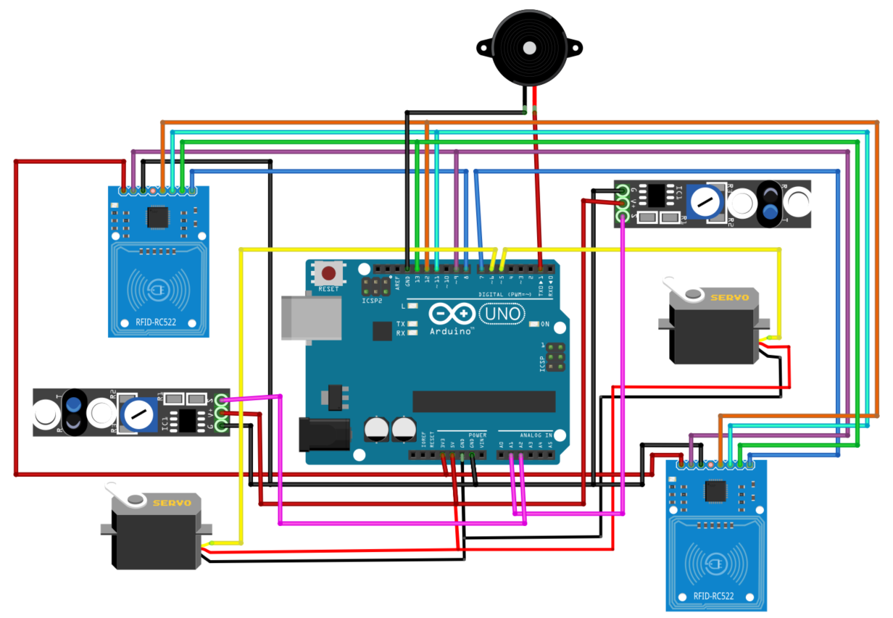
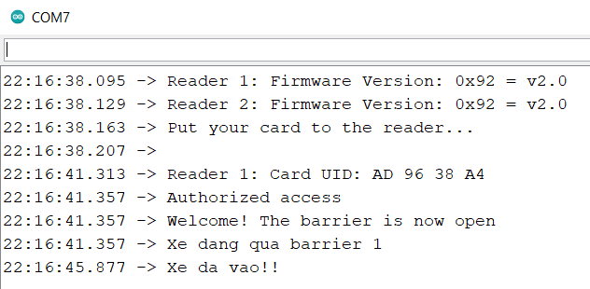

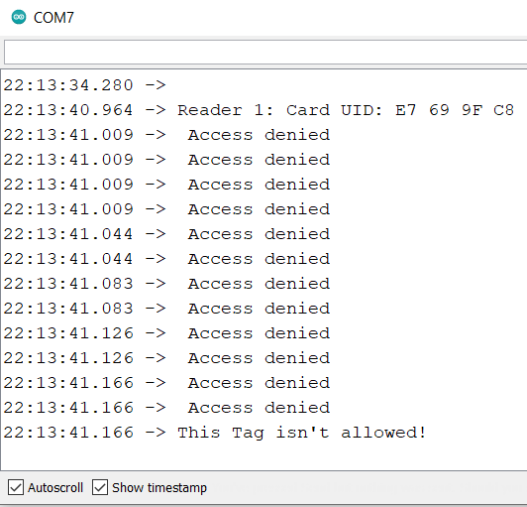

3.2 Vehicle access management system
Accept
Deny

Slide 16
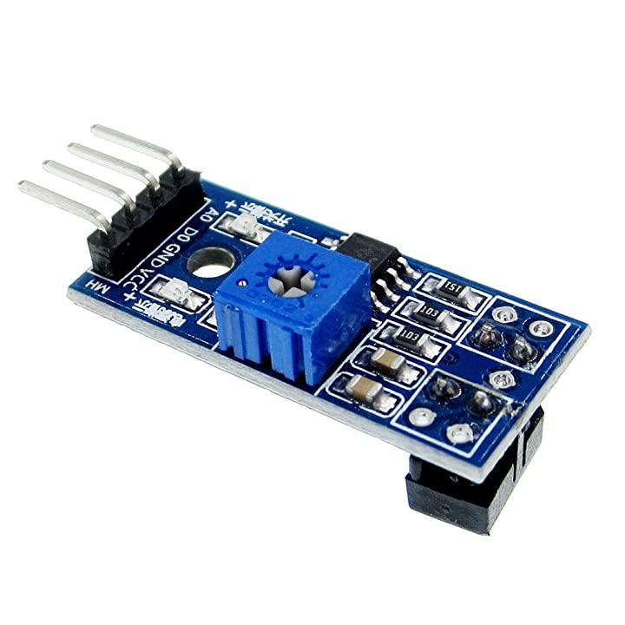
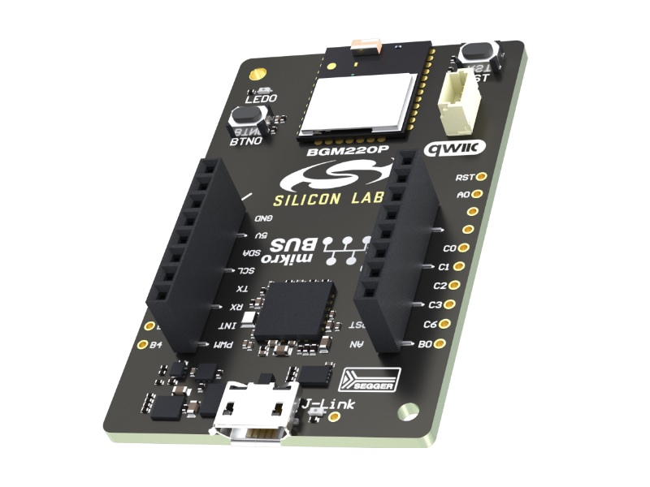

3.3 Parking lots management
IR Sensor
Detecting the car in the parking position
BGM 220
Read data from sensors and send to Pi
Raspberry PI
Receive data from parking space

Slide 17
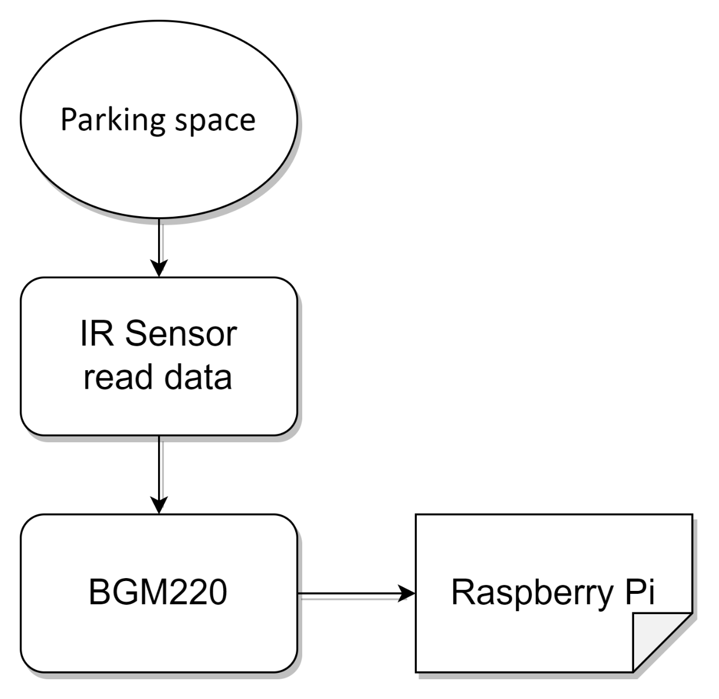


3.3 Parking lots management

Slide 18
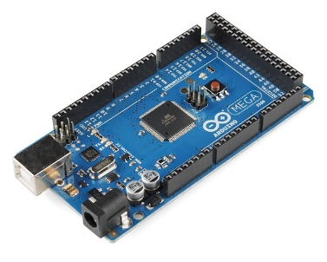
3.4 Comunication protocol
UART
Simple form of digital communication between 2 devices
No need for clock signal
Easy to use, error correction control
I2C
Synchronous serial communication protocol
Just have 2 common bus lines
No agreement needed on baudrates
Easy to expand
UART
Gateway
I2C

Slide 19
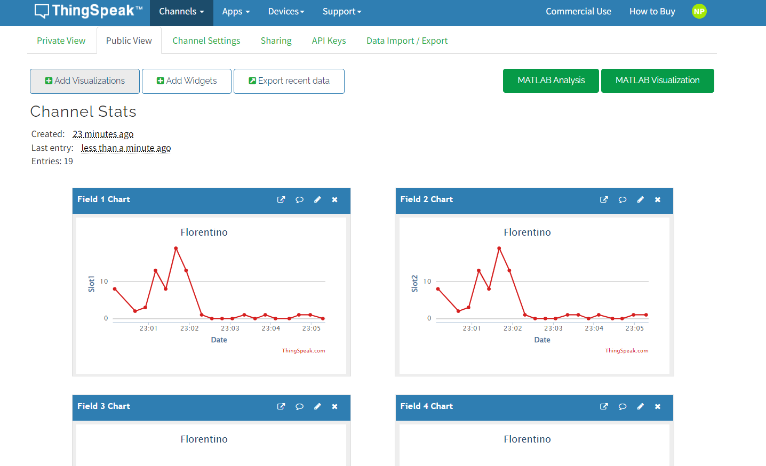
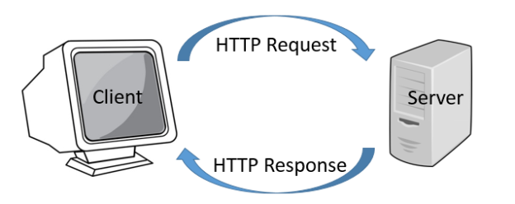
3.5 Cloud
ThingSpeak Platform

Slide 20
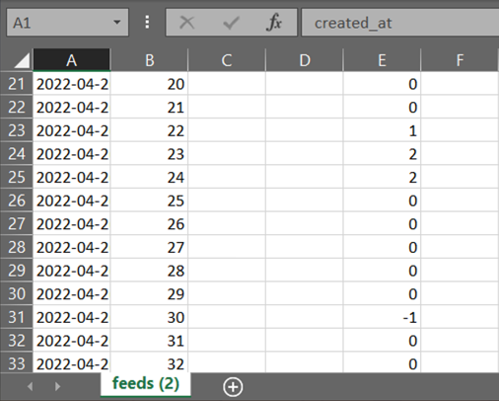
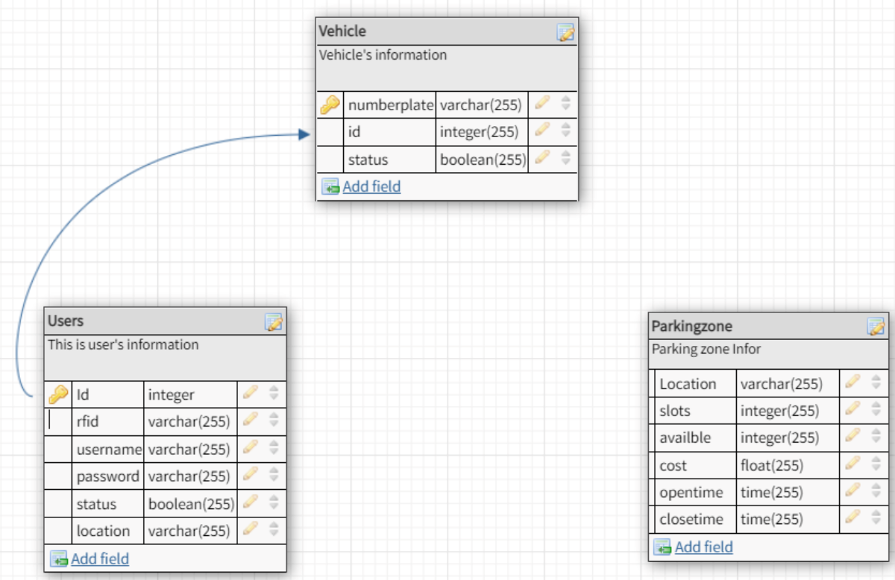
3.5 Cloud
Normalize raw data to useful data

Slide 21
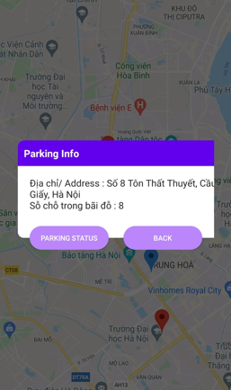
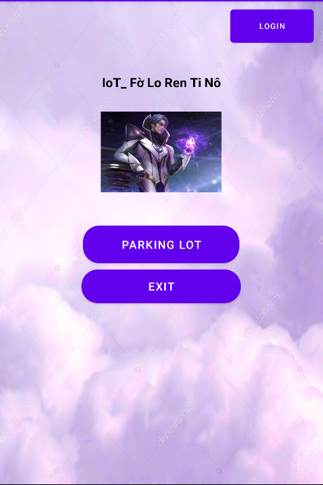
3.6 Mobile App User Interface

Slide 22
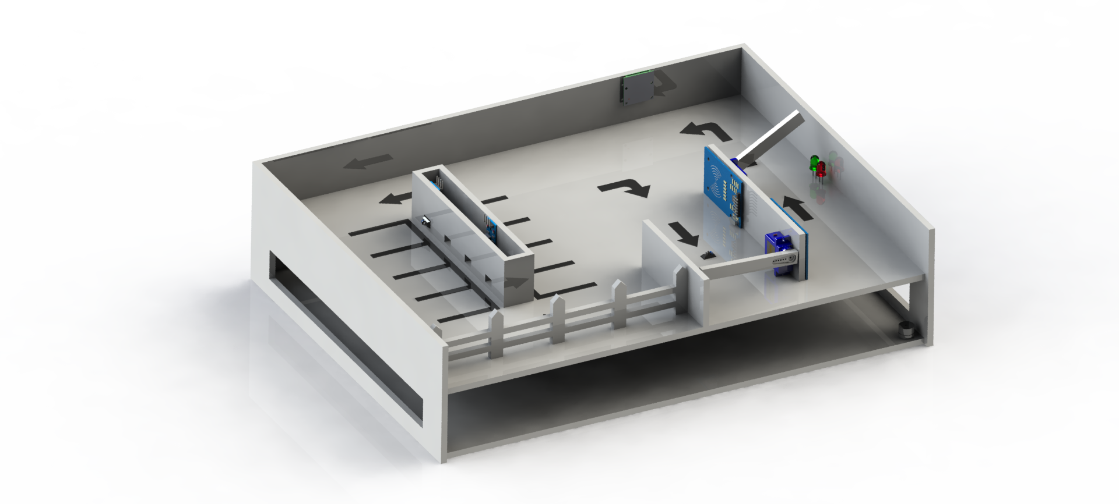
3.7 3D Design

Slide 23
4. Summary

Slide 24


Slide 25
5. Development ideas

Slide 26
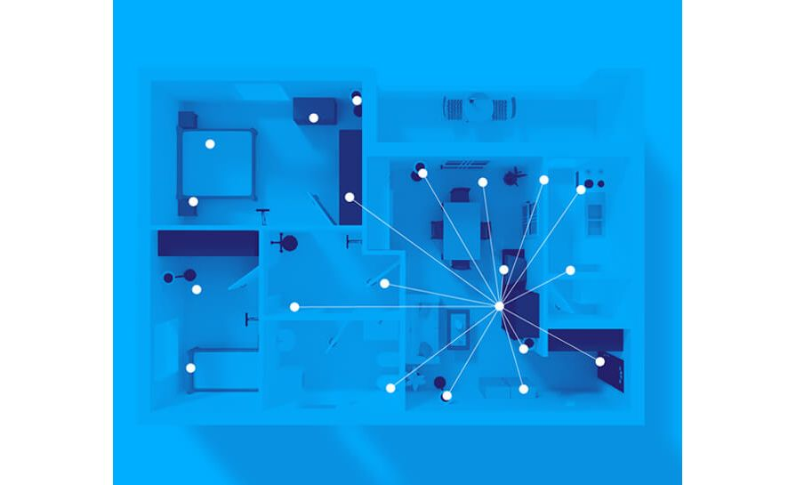
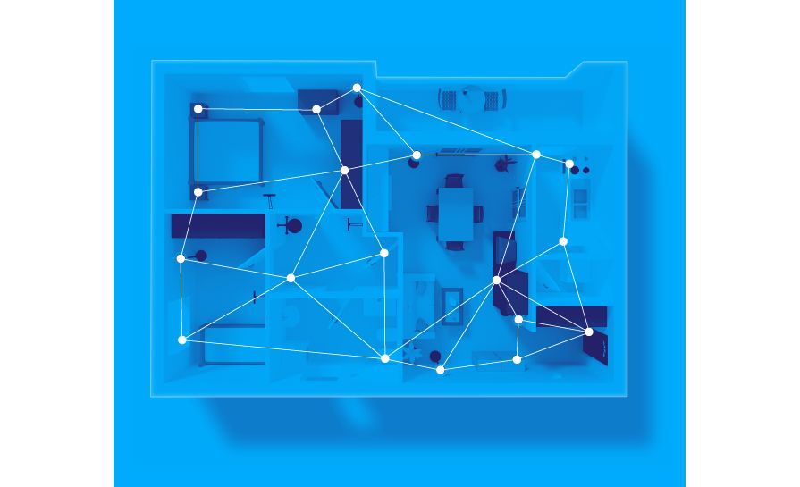
5.1 Network Topology
Star
Mesh

Slide 27

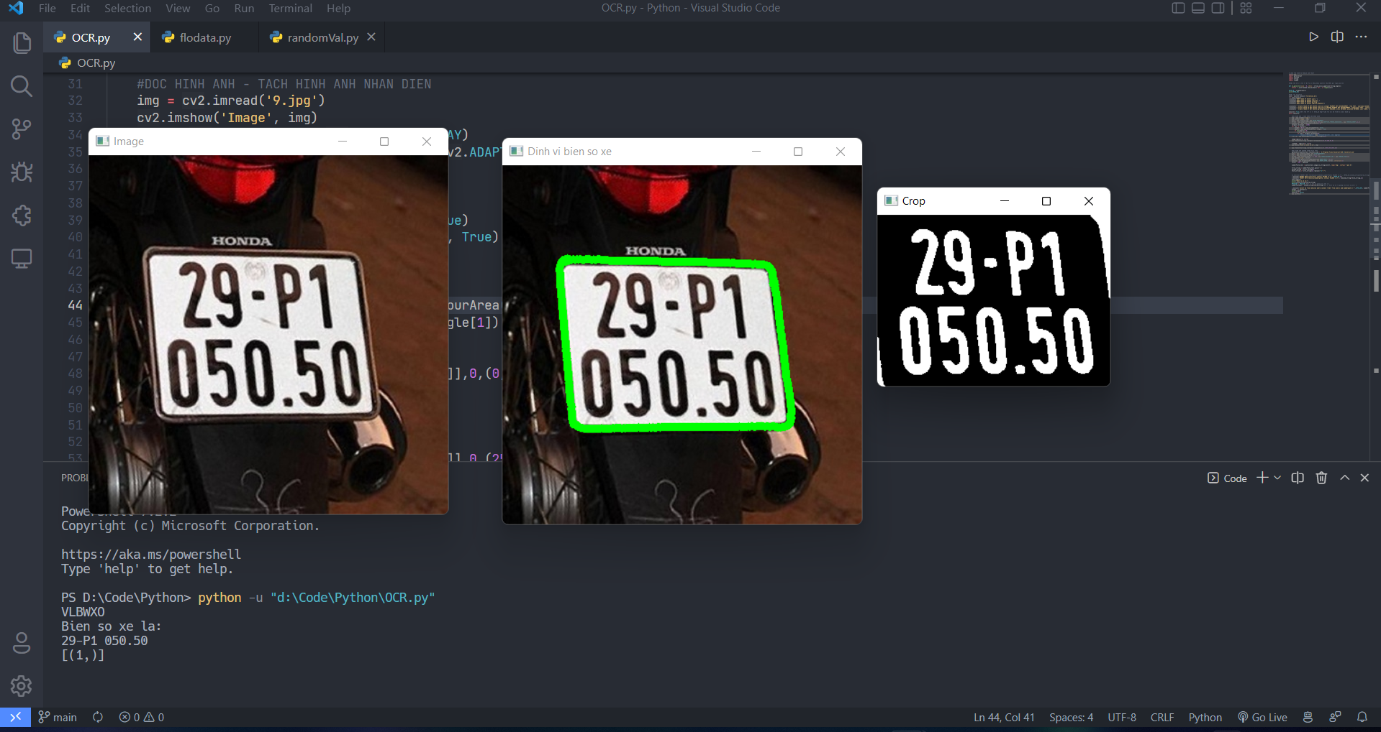

5.2 License Plate Tracking and Data Management
Gateway
Database

Slide 28
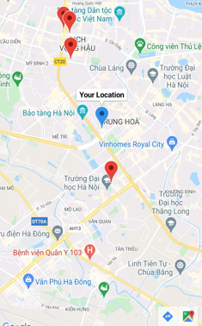
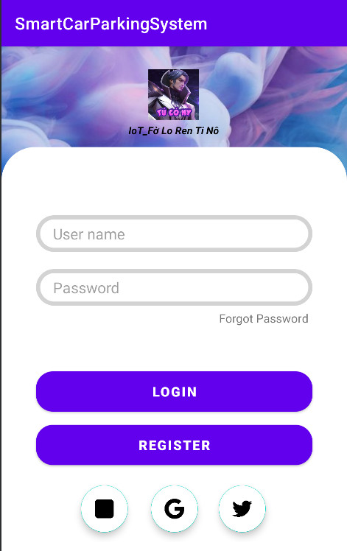
5.3 Personal vehicle management
GPS
Log in Interface

Slide 29
